Slide 1
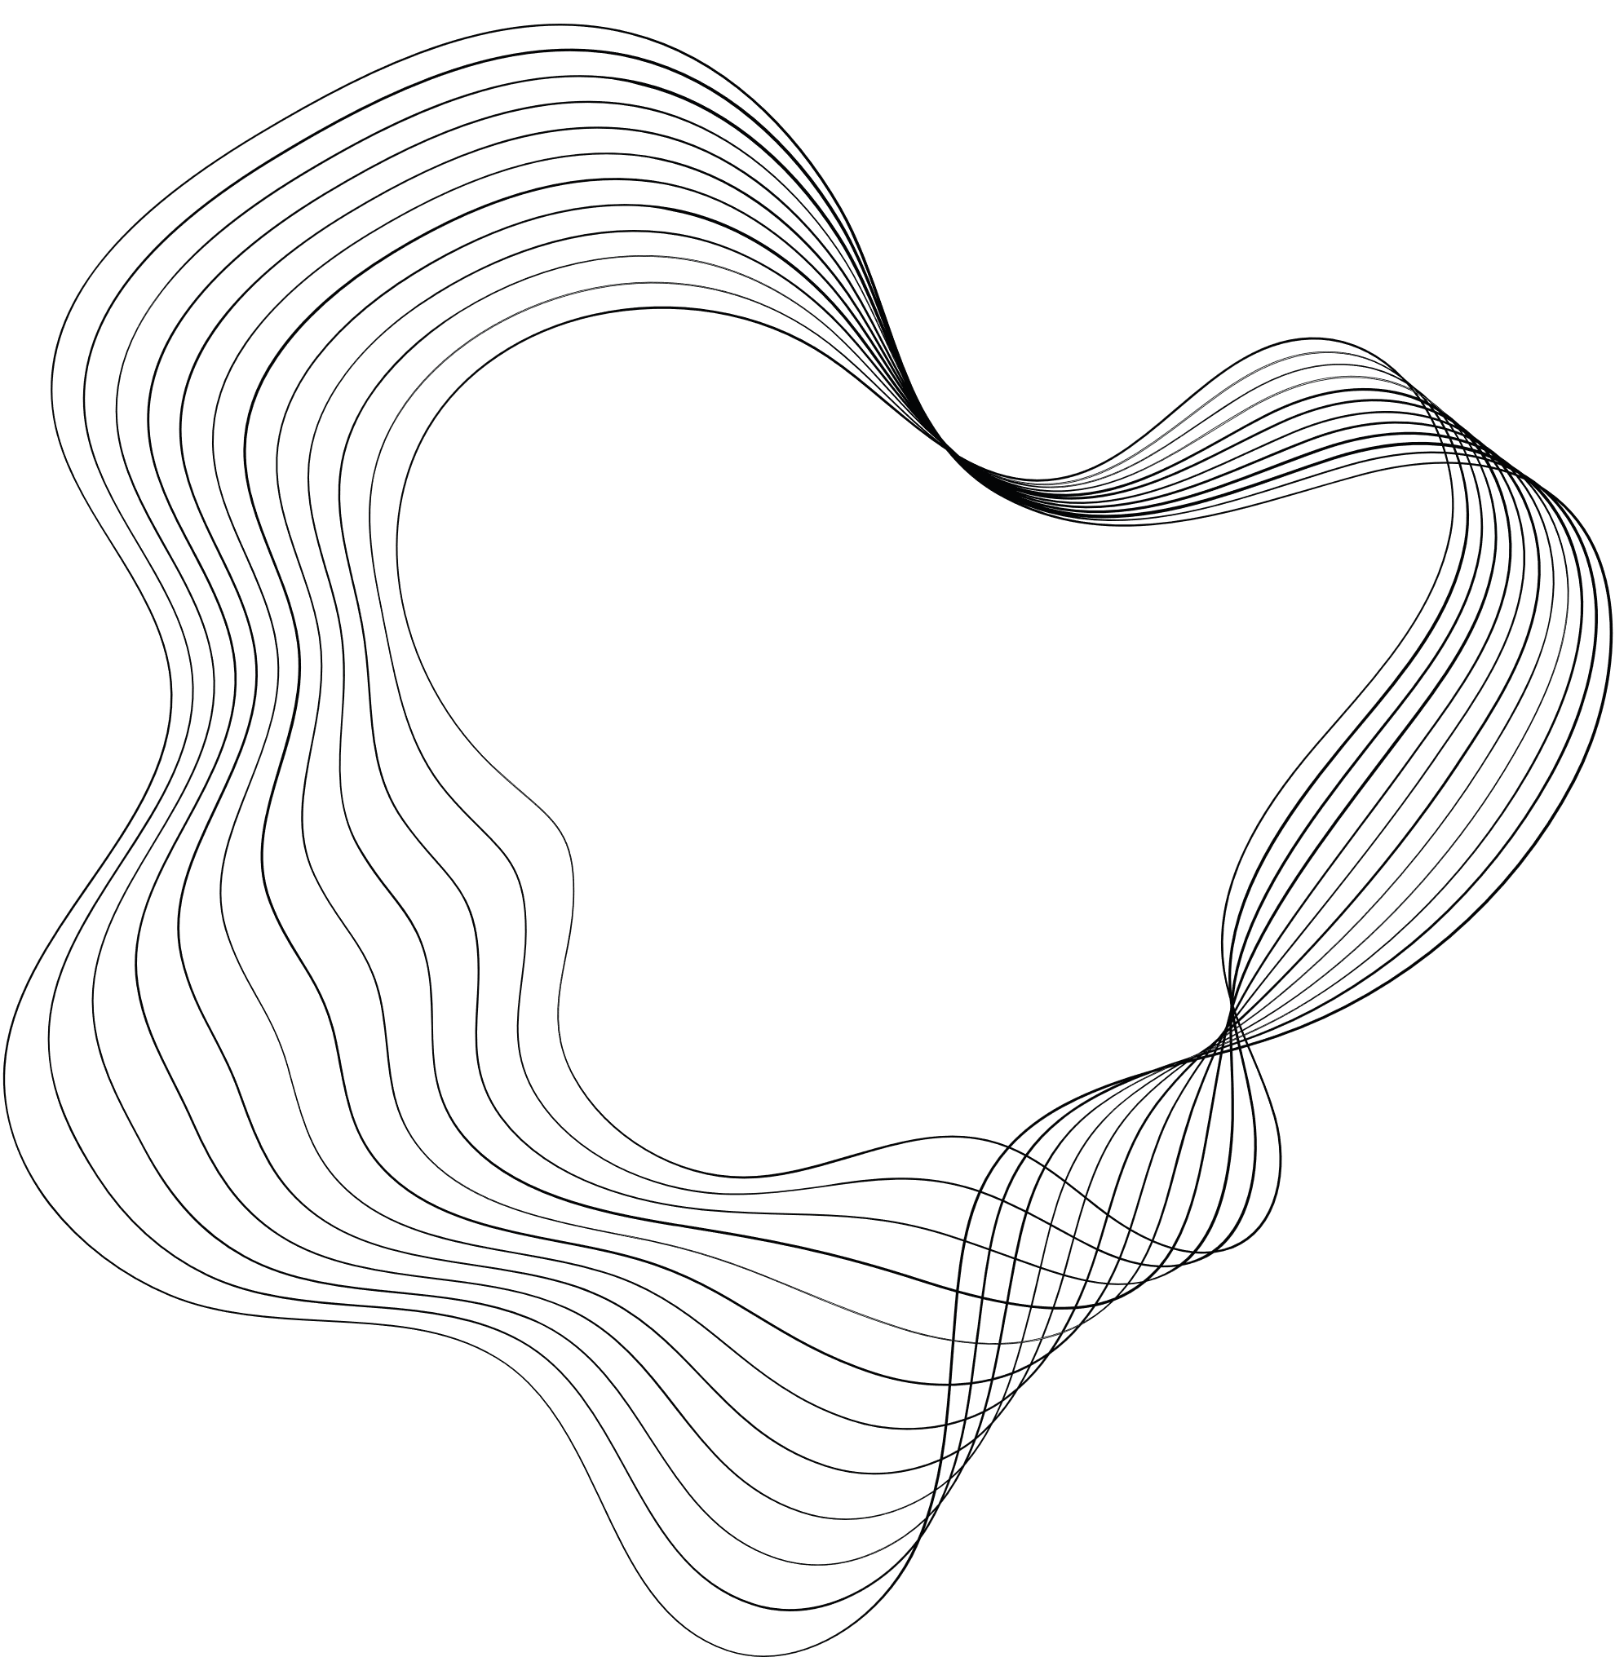


FINAL PROJECT
BRIDGING THE GAP: OPTIMIZING RISK FOR FINANCIAL INVESTORS AND MINIMIZING ECONOMIC CAPITAL CONSUMPTION
GROUP-6

Slide 2

GROUP-6
NIHARIKA DOBBANABOINA
ZACHERIA
ALEX
RACHANA
KURRA
TILAK KUMAR BONALA
Ceo Of Ingoude Company
Ceo Of Ingoude Company

Slide 3
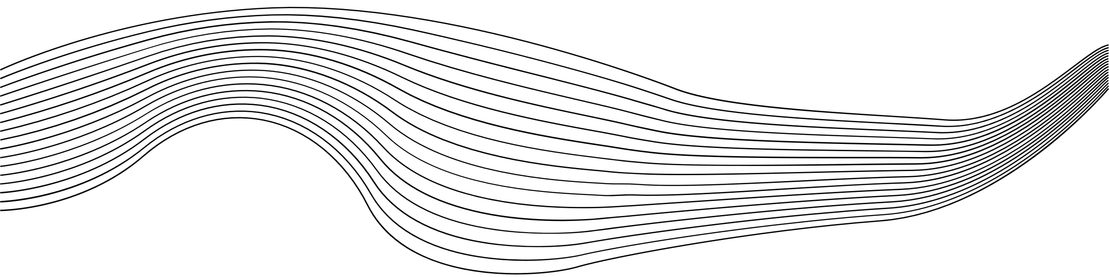
CONTENT
01
ABSTRACT
02
PROBLEM STATEMENT
03
OVERVIEW
04
MODELLING STRATEGY
05
ESTIMATION OF MODEL'S PERFORMANCE
06
INSIGHTS
07
CONCLUSION

Slide 4



ABSTRACT
The banking industry faces the challenge of balancing the need to promote loan applications while mitigating the risk of default and capital loss
Banks need an effective risk assessment system to make informed decisions based on customer behavior data and mitigate the risk of loan defaults

Slide 5



PROBLEM STATEMENT
Project aims to minimize investment risks and losses while maximizing profits by analyzing client profiles and their loan default probability, enabling informed lending decisions.
DEFAULT LOSS

Slide 6
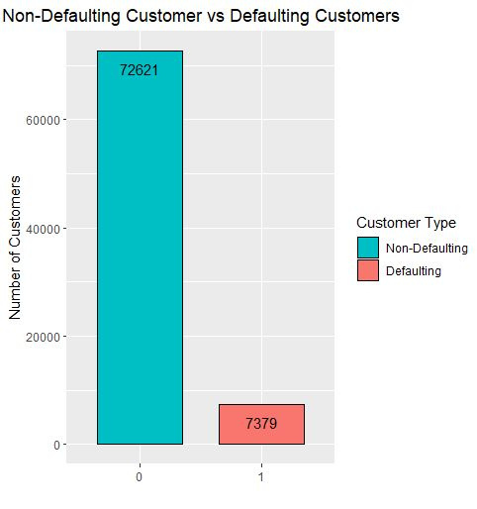
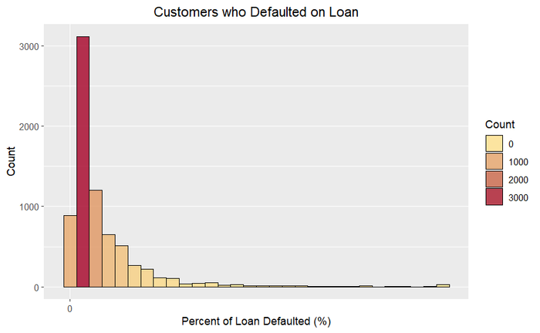
OVERVIEW WITH EDA
80 000 (80k) observations with 764 variables
40 570 observations containing missing (NA)
521 variables containing missing (NA)
10 variables with no variance
STRUCTURE OF DATA
DATA EXPLORATION
In 80k observations, 9.22% is the default rate
percentage of clients who paid the complete loan maximum than the defaulter count
DATA CLEANING
More than 30% of columns containing null values are removed.
remaining are replaced with median value

Slide 7



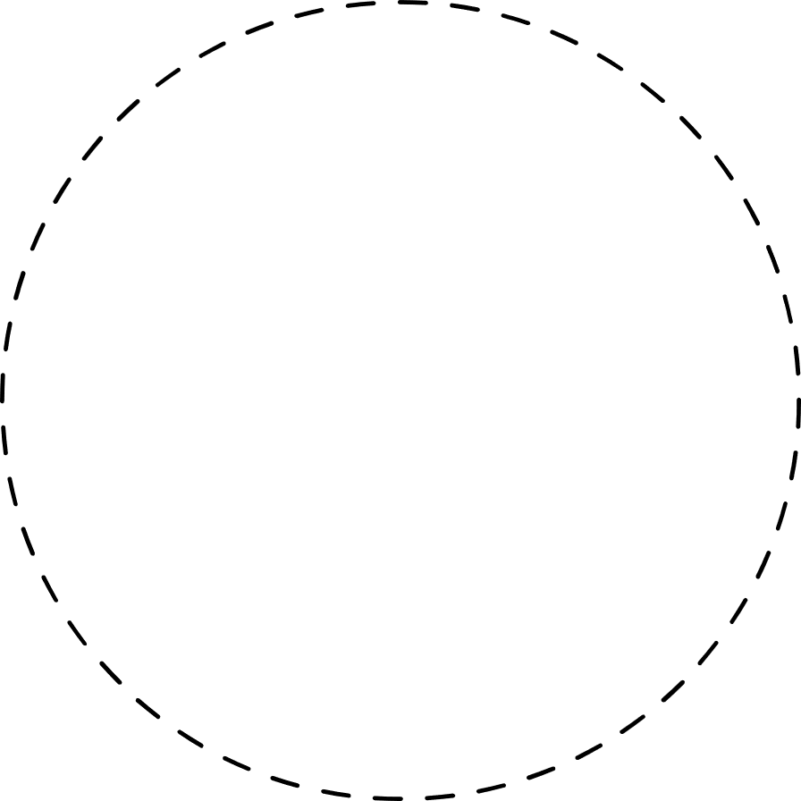


APPROACH
LOSS = 0 - DEFAULT = 0
LOSS = 1 - DEFAULT = 1
SCALLING THE DATA
Classification: Lasso and Gradient boosting
Regression: Lasso and Random Forest
FEATURE ENGINEERING
we used collinearity analysis to determine the extent to which the relationship between independent variables affects the default percentage.
LASSO regression is used to reduce no. of features of the data
FEATURE SELECTION
MODEL SELECTION

Slide 8



MODELLING STRATEGY
1.REGRESSION
HYPERPARAMETERS
MTRY
DEPTH OF TREE
NO. OF SAMPLES
01
02
03
PERFORMANCE METRIC
RESULT
SPLITTING
GROWING TREE
MAE=0.062
Splitting Data into
70:30 ratio for traning and validation
grow tree of
max depth = 100 and sample of 50 observations
MAE, which is decreasing as we increase the sample

